Slide 1
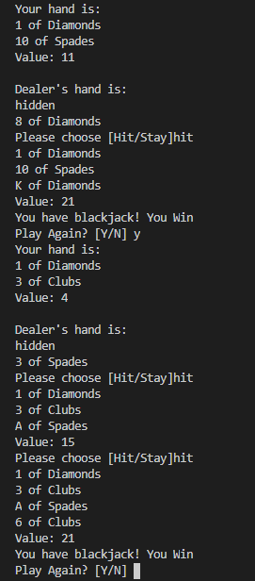
Text-Based Blackjack Game
By: Sally Luo
A simplified version of a classic casino blackjack game. The game is played through the terminal and is written in Python 3. The player and dealer is dealt 2 cards each, with one of the dealer’s being hidden. The player has the option to “hit” or “stay” after seeing the value of their cards. Classic rules apply: face cards are valued at 10, number cards are face value, and Aces can be 11 or 1 depending if paired with a face card.
https://github.com/ksu-is/Text-Based-Blackjack-Game

